Slide 1






Future of SME with Budget 2021
(Mainly in Tax Angle)
ATHULA RANAWEERA (BSc., FCA, FCMA, FMAAT)
email – athula@assentadvisory.lk, athula@ranaweeraasso.lk
Phone – +94 777 305 123 11. 01. 2021

Slide 2
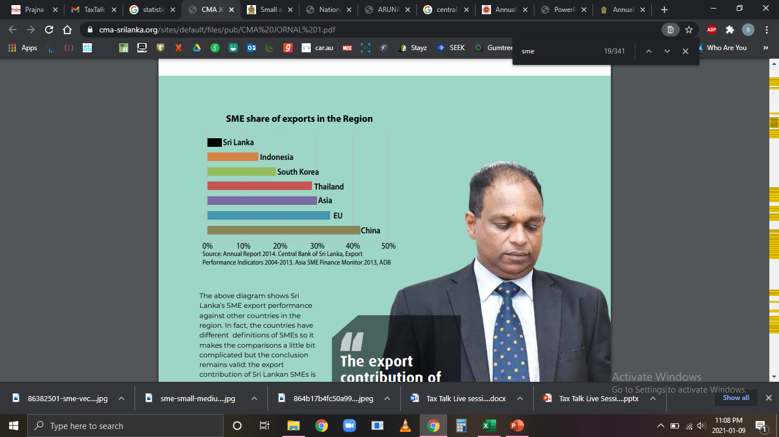
Future of SME with Budget 2021
1. Introduction
Why should we talk about SME? ……………..
Prominence in the economy (Volume, coverage of Community & Resources etc…)
SME contributes to;
45% of Domestic Employment
52% of GDP
(2018 – 2020)

Slide 3
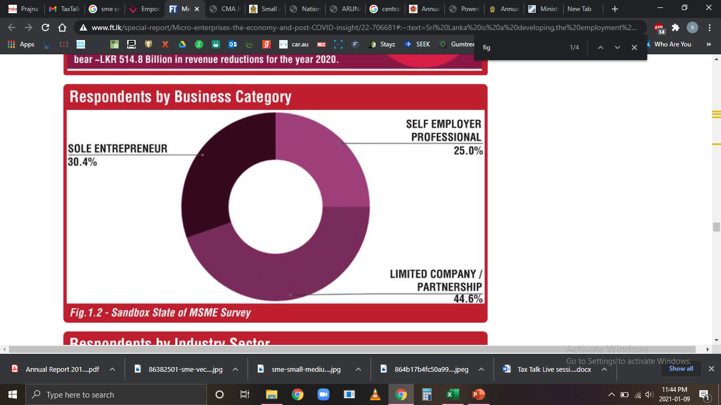
Future of SME with Budget 2021
1. Introduction (Contd.)
Why should we talk about SME? ……………..
Source: Daily FT

Slide 4
Future of SME with Budget 2021
1. Introduction (Contd.)
What Concessions & Supports to SME Through Budget?
Tax Concessions
Through Income Tax, VAT, ESC, NBT, Tax Policies, Tax Amnesty.
Other Concessions & Supports
Through Providing Resources (financial or otherwise) & Services.

Slide 5
Future of SME with Budget 2021
1. Introduction (Contd.)
Tax Concessions
What an “SME” is under IR Act?
“Small and Medium Enterprise” means a person who satisfies the following conditions:—
a) the person who conducts business solely in Sri Lanka other than an individual who is engaged in providing professional services individually or in partnership being an individual who is professionally qualified;
b) the person does not have an associate that is an entity; and
c) the person’s annual gross turnover is less than Rs. 500,000,000; (Sec. 195 of IR Act)

Slide 6

2. Tax Concessions/Reliefs to SMEs (IR Act)
Tax Concessions through IR Act No. 24 of 2017

Slide 7
2. Tax Concessions/Reliefs to SMEs (IR Act) (Contd…)
Basics of Income Tax Computation
Income Tax = | Taxable Income x Tax Rate/s
Taxable Income = | Assessable Income – QPs & Reliefs
Assessable Income of Business/Investment = | Gross T/O-Allowable Expenses (Sec. 11 & ….)
Assessable Income from Employment = | Gross Employment Income

Slide 8
2. Tax Concessions/Reliefs to SMEs (IR Act) (Contd…)
Tax Concessions through IR Act No. 24 of 2017
Concessionary IT rate of 14 % for SME (Schedule 1 to the IR Act)
Allow the partners’ loan interest & service fees as an allowable expense of the partnership under the IR Act [Sec. 53(7)]
Research and Development expenses double deduction
200% of the cost (Both, Revenue + Capital)
“A person is entitled to an additional deduction when calculating the person’s income from business for a year of assessment equal to 100% of the total amount of research and development expenses deducted for the year under Section 15, for three years of assessment after the commencement of this Act”. (Schedule 6)

Slide 9
2. Tax Concessions/Reliefs to SMEs (IR Act) (Contd…)
Tax Concessions through IR Act No. 24 of 2017 Contd…
Agriculture start up expenses (Including Capital Expense) – (Sec. 15)
(a) Land opening, (b) Cultivating, (c) Purchase of livestock/ poultry,
(d) maintaining/clearing tanks, ponds & inland water for rearing of fish.
Relaxation of non-companies from Thin Capitalization requirement (Sec. 18)
(Limitation of claiming interest cost of a Company)
Facility of Claiming of Losses, if any; (Sec. 19)
Facility of C/F for next 6 years
Facility of claiming Business Losses even against Investment Income

Slide 10

3. Tax Concessions/Reliefs to SMEs (Proposed)
Tax Concessions through recent Government Announcements
(Pending Legislation)

Slide 11
3. Tax Concessions /Reliefs to SMEs (Proposed)(Contd…)
VAT relaxations* –
Reduction of tax rate from 15% to 8% (w.e.f. 01.12.2019)
Extending annual VAT threshold from Rs.12mn to Rs.300mn(w.e.f. 01.01.2020)
Exempting travel agents (registered with SLTDA) from VAT(w.e.f. 01.04.2020)
ESC Abolition* (w.e.f. 01.01.2020)
NBT Abolition* (w.e.f. 01.01.2020)
Reduction of a few custom duties (but bad effects on introduction of CESS)
Introduction of GST by amalgamating multiple taxes (Liquor, tobacco, vehicles, certain Agro products).
* Persons Released (Due to the threshold/abolishing) - Close the tax file w.e.f. 01.01.2020.

Slide 12
3. Tax Concessions/Reliefs to SMEs(Proposed)(Contd…)
Income Tax
Removal of individuals’ tax exemption limit of Rs. 15mn on foreign services.
Exempting Agro Farming, IT & Foreign Services income of any person.
For proprietors, partners, directors & other employees - Tax benefits from;
(a) Increasing the individuals’ personal allowance up to Rs.3mn p.a.
(b) Introduction of expenditure relief of Rs.1.2mn.
(health, medical insurance, local education, housing loan interest, approved pension scheme contributions, purchase of equity/security)
(c) Widening of tax slabs (Rs.3mn each) & introduction of 3 rates (6%,12% &18%).
(d) Concessions on Terminal benefits (Rs.10mn @ 0%, next Rs. 10mn@6% & balance@12%)

Slide 13
3. Tax Concessions /Reliefs to SMEs (Proposed)(Contd…)
WHT - Abolition of most of the WHTs of Residents
(Business freedom & relaxing from WHT agency services)
Income Tax relating to Partnerships –
(Joint Venture is also a partnership)
Change of WHT of 8% on allocation to P/ship Tax of 6% (tax credits available)
Introduction of Rs. 1 Mn. relief from AI to arrive in TI (w.e.f. 01.01.2020)

Slide 14

4. Tax Concessions/Reliefs to SMEs (Other)
(iii) Other Tax Concessions / Reliefs Proposed

Slide 15
4. Tax Concessions /Reliefs to SMEs (Other)(Contd.)
Proposing of continuity of tax policies for next 5 years without changes.
Concession on VAT liability on products manufactured with materials exempted from import VAT.
Introduction of a CESS on imports as a measure of promoting local manufacturing.
Import duty reduction on vehicle spare parts to promote repairs & local assembling.
7 years IT holiday on boat manufacturing.
5years IT holiday for private professional training businesses doubling student number.

Slide 16
4. Tax Concessions /Reliefs to SMEs (Other)(Contd.)
Establishing a Special Tax Appeal Court.
Compulsory e-filing of Company IT returns (w.e.f 01.04.2021)
Release the interest income of the welfare societies and institutions from IT.
To simplify, Capital Gains will be calculated on the higher of the sale price or the assessed value of a property.
7 years tax holiday for all renewable energy projects.
Special commodity levy on importation of selected agricultural products.
Tax amnesty for investment of non-tax paid money by entrepreneurs after paying 1% tax.

Slide 17

5. Concessions/Reliefs to SMEs (Non-Tax)
(iv) Proposed Other (Non-Tax) Concessions/
Reliefs

Slide 18
5. Concessions /Reliefs to SMEs (Non-Tax)(Contd.)
Other Non-Tax Concessions/Reliefs
7% special loan scheme to “Samurdhi” beneficiaries.
Expenses on promoting women entrepreneurships to be allowed for IT.
Introduction of Covid Insurance Scheme with Government contribution of 0.2% of the T/O;
Any business with more than 50 employees.
Retail & wholesale trading and hotels having more than 5 employees.

Slide 19
5. Concessions /Reliefs to SMEs (Non-Tax)(Contd.)
Other Non-Tax Concessions/Reliefs (Contd…)
Contributory pension scheme for self-employees after 65 years of age.
New National Development Banking Corporation (By merging State Mortgage & Investment Bank, Housing Development & Real Estate Ltd and Regional Development Banks)
Additional Rs. 2 per dollar for the foreign exchange remittances by workers.
Start-up capital loans of Rs.500,000 @ 4% to young men and women who completed vocational education, with a tax exemption of 5 years.
Amend the Public Utilities Commission Act and Ceylon Electricity Board Act to allow rapid implementation of power projects.

Slide 20
5. Concessions /Reliefs to SMEs (Non-Tax)(Contd.)
Other Non-Tax Concessions/Reliefs (Contd…)
Import of dairy cattle.
Import limitation on agricultural commodities.
Capital grants of Rs.150,000 to 10,000 to small and medium scale commercial agro entrepreneurs, to install solar powered water pumps.
Custom duty reliefs and financing facilities to obtain land and modern equipment for investing in value additions to local crops.
Free fertilizer for paddy and a 50 Kg of fertilizer at Rs. 1,500 for other crops.

Slide 21

FOR FURTHER CLARIFICATIONS PLEASE COMMUNICATE WITH US ………
ATHULA RANAWEERA (BSc., FCA, FCMA, FMAAT)
Managing Partner: Ranaweera Associates (Chartered Accountants)
Managing Director - Assent Advisory Partners (Pvt) Ltd.
Assent Secretarial Consultants (Pvt) Ltd.
+94 777 305 123,
athula@ranaweeraasso.lk athula@assentadvisory.lk

