Slide 1
Professional Review on INLAND REVENUE (AMENDMENT) BILL
ATHULA RANAWEERA (BSc., FCA, FCMA, FMAAT) email – athula@assentadvisory.lk, athula@ranaweeraasso.lk
Phone – +94 777 305 123 08 04. 2021
AMENDEMENTS TO INLAND REVENUE ACT

Slide 2
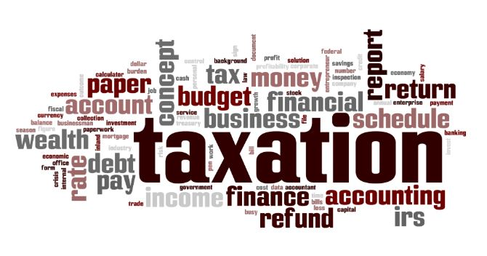
INLAND REVENUE (AMENDMENT) BILL 1. Introduction
• Issued on 18.03.2021
• Order Paper filed in the Parliament on 26.03.2021
The determination of the Supreme Court on the
F/R Cases against the Bill is finalized on 07.04.2021
A long-awaited amendments :
(i) To rectify identified errors & loopholes in the original Act No. 24 of 2917,
To accommodate numerous amendments proposed after November 2019 and activated without legal backing,
To accommodate numerous amendments proposed through Gov. Budget 2021.

Slide 3
INLAND REVENUE (AMENDMENT) BILL 1. Introduction (Contd.)
Varying effective dates –
• 01.04.2018,
• 01.04.2019,
• 01.01.2020,
• 01.04.2020,
• 01.04.2021.
Legalization – Through the Parliament in near future (after the committee level amendments, if any).
Public Objections – Through Supreme Courts. (Needs to file a case on or before 01st April 2021.

Slide 4
INLAND REVENUE (AMENDMENT) BILL 2. Employment Income
Sec.5(3)(c) – Dental, medical or health insurance benefit receiving as an Employment Income was excluded from IT, only if the said benefit is available to all fulltime employees on equal terms. Now proposed to change it to read as “in the same grade of the service, on equal terms”.
Sec. 5(3)(f) – Benefits out of the contributions made by an employer to employee’s accounts with pension, provident or savings fund or approved savings society were excluded from IT.
Now “gratuity funds” are also included into the exemption.

Slide 5
INLAND REVENUE (AMENDMENT) BILL 3. Exempt Income (Reference to Third Schedule)
Sec. 9(3) – Amending to accommodate any tax exemptions giving under Strategic Development Project Act No. 14 of 2008 (SDPA) by superseding the IR Act limitations. (SDPA was inactive for several years).
Third Schedule (Exemptions) – New Additions;
(hh) a gain made by a person on or after 1st April 2021 from the realisation of land or building which was sold, exchanged or transferred to a Real Estate Investment Trust listed in the Colombo Stock Exchange and licensed by the Securities and Exchange Commission of Sri Lanka;

Slide 6
INLAND REVENUE (AMENDMENT) BILL 3. Exempt Income (Reference to Third Schedule)
(ll) a gain from the realisation of Sri Lanka international sovereign bonds issued by or on behalf of the Government of Sri Lanka and received or derived by a commercial bank or authorized dealer who made an aggregate investment not less than USD 100 million in such bonds on or after 1st April 2021
(lll) interest or discount accrued or derived on or after 1st April 2021 by any Samurdhi community-based banks established under the Department of Samurdhi Development from security or treasury bonds under the Registered Stocks and Securities Ordinance (Chapter 420) or treasury bills under the Local Treasury Bills Ordinance (Chapter 417)

Slide 7
INLAND REVENUE (AMENDMENT) BILL 3. Exempt Income (Reference to Third Schedule)
(oo) on or after 1st January 2020, a dividend paid by a resident company;
(i)to a member to the extent that such dividend payment is attributable to, or derived from, gains and profits from dividend received by that resident company.
(here the, “gains and profits from dividend” means the dividend received by that company after the deduction of expenses or losses, if any, subject to the provisions of this Act & income tax paid/payable on such dividend received by that company)
(ii) to a non-resident member.
(iii)which is engaged in any one or more of the following businesses in accordance with the provisions of Part IV of the Finance Act, No. 12 of 2012 and which has entered into an agreement with the Board of Investment of Sri Lanka established under the Board of Investment of Sri Lanka Law No. 4 of 1978:
(iiia) entrepot trade involving import, minor processing and re-export;

Slide 8
INLAND REVENUE (AMENDMENT) BILL 3. Exempt Income (Reference to Third Schedule)
(iiib) offshore business where goods can be procured from one country or manufactured in one country and shipped to another country without bringing the same into Sri Lanka.
(iiic) providing front-end services to clients abroad.
(iiid) headquarters operations of leading buyers for management of financial supply chain and billing operations.
(iiie) logistics services including bonded warehouse or multicountry consolidation in Sri Lanka.
(rr) dividends and gains on the realisation of units or amounts derived as gains from the realization of capital assets of a business or investment by a unit holder, from Real Estate Investment Trust listed in the Colombo Stock Exchange and licensed by the Securities and Exchange Commission of Sri Lanka.

Slide 9
INLAND REVENUE (AMENDMENT) BILL 3. Exempt Income (Reference to Third Schedule)
(t) any amount derived on or after 1st April 2018, by any non-resident person as any payment for aircraft, software licenses or as for other related services from the Sri Lankan Airlines Limited.
(u) the gains and profits earned or derived by any person from-
the sale of produce from agro farming of such person within the period of five years of assessment commencing from 1st April 2019.
Provided that in relation to an undertaking which consists of the production of agro farming produces and utilizing such produce to agro processing or manufacture of any product, such produce shall be deemed to have been sold for the agro processor or manufacturer at the market price prevailing at the time of such deemed sale, and the gains and profits computed on the basis of such deemed sale in relation to the agro farming shall be considered as exempt gains and profits within the period of five years of assessment commencing on 1st April 2019.

Slide 10
INLAND REVENUE (AMENDMENT) BILL 3. Exempt Income (Reference to Third Schedule)
(ii) providing information technology and enabled services on or after 1st January 2020, as may be prescribed. (Await for the prescription).
(iii) any service rendered in or outside Sri Lanka to any person to be utilized outside Sri Lanka, where the payment for such services is received in foreign currency and remitted through a bank to Sri Lanka on or after 1stJanuary 2020.
(iv) any foreign source [other than gains and profits referred to in subparagraph (iii)] where such gains and profits are earned or derived in foreign currency and remitted through a bank to Sri Lanka on or after 1st January 2020.

Slide 11
INLAND REVENUE (AMENDMENT) BILL 3. Exempt Income (Reference to Third Schedule)
(v) any vocational education programmes of any Vocational Education Institution which is standardized under Technical and Vocational Education and Training concept (TVET concept) and regulated by the Tertiary and Vocational Education Commission,
(a) if such institution has doubled its student intake of the vocational education programmes for such year of assessment compared to the student intake of such programmes in the year of assessment immediately preceding that year of assessment.
(b) for a period of five years commencing on 1st April 2021.

Slide 12
INLAND REVENUE (AMENDMENT) BILL 3. Exempt Income (Reference to Third Schedule)
Provided however, for the purpose of paragraph (a), any institution which doubled the student intake of the vocational education programmes as provided for in the first year and maintained the same student intake of such programmes of the first year for the next four years shall be deemed as an institution which fulfilled the requirement in such years.
(vi) any business of export of gold, gems or jewellery or from the business of cutting and polishing of gems which are brought to Sri Lanka and exported after such cutting and polishing, where such gains and profits earned in foreign currency are remitted through a bank to Sri Lanka, with effect from 1st April 2021.

Slide 13
INLAND REVENUE (AMENDMENT) BILL 3. Exempt Income (Reference to Third Schedule)
(v) any amount derived on or after 1st January 2020 by;
(i) any non-resident person from laboratory services or standards certification services.
(ii) any religious institution which is registered with the Ministry in charge of the subject of religious affairs, by way of grants or donations.
(w) gains and profits received or derived from business (other than any gains from the realisation of capital assets and liabilities of the business as calculated under Chapter IV of this Act) by a person from following any new undertaking (which is not formed by splitting-up or re-construction of an existing undertaking) commenced on or after 1st April 2021, for that period, subject to the conditions contained herein;

Slide 14
INLAND REVENUE (AMENDMENT) BILL 3. Exempt Income (Reference to Third Schedule)
(i) an undertaking which is involved in the sale of construction materials recycled in a selected separate site established in Sri Lanka to recycle the materials which were already used in the construction industry, (a person who is involved in the provision of construction services using construction materials recycled by him from a site with the same conditions, in the provision of such services provided by him shall be deemed to have sold such materials for the construction service at a market price prevailing at the time of such deemed sale), for a period of ten years.
(ii) any business commenced on or after 1st April 2021 by an individual after successful completion of vocational education from any Vocational Education Institution which is standardized under Technical and Vocational Education and Training concept (TVET concept) and regulated by the Tertiary and Vocational Education Commission, for a period of five years.

Slide 15
INLAND REVENUE (AMENDMENT) BILL 3. Exempt Income (Reference to Third Schedule)
(iii)an undertaking commenced by a resident person for the purpose of manufacturing of boats or ships in Sri Lanka and received or derived any gains and profits from the supply of such boats or ships, for a period of seven years.
(iv) any renewable energy project established with a capacity to produce not less than one hundred Mega Watts of solar or wind power and supplied such power to the national grid, for a period of seven years.
(v) an undertaking commenced on or after January 1, 2021 by any resident person who constructs and installs communication towers and related appliances using local labour and local raw materials in Sri Lanka or provides required technical services for such construction or installation, for a period of five years.

Slide 16
INLAND REVENUE (AMENDMENT) BILL 3. Exempt Income (Reference to Third Schedule)
(vi) an undertaking for letting bonded warehouses or warehouses related to the offshore business in the Colombo and Hambanthota Ports, if such person has invested on such undertaking on or after 1st April 2021.
Tax exemption periods provided in the above subparagraphs [other than in subparagraph (vi)] shall be reckoned from the year of assessment in which the undertaking commences to make profits (assessable income from such business) from transactions entered into in that year of assessment or from the commencement of the year of assessment immediately succeeding the year of assessment in which the undertaking completes a period of two years reckoned from the date on which the undertaking commences to carry on commercial operations, whichever occurs earlier.”

Slide 17
INLAND REVENUE (AMENDMENT) BILL 4. Allowable & Disallowable Expenses, Outlays & Losses
Sec 10(1)(b)(v) –
Contributions to gratuity funds by employers which are not included into employment income are also included into the disallowable list.
(Please be noted that though it is included into employment income, under Sec. 5(3)(f) it is excluded and hence to be treated as included and allow the expense).
Sec 11(4) –
Adding (4) to treat the cost of funds incurred on loans granted to vocationally trained persons as an allowable expense (incurred in the production of income) of the financial institution. (When it is obvious, why is this clause????)

Slide 18
INLAND REVENUE (AMENDMENT) BILL 4. Allowable & Disallowable Expenses, Outlays & Losses (Contd.)
Sec 14 – Repair & Improvements –
• W.e.f. 01st April 2021 the maximum limitation of claiming (i.e., 5% of WDV of depreciable buildings & 20% of WDV of other depreciable assets) of expenses is applicable only on cost of improvements & not on repair cost.
• “Improvement” is defined to include the expenditure incurred to long term enhancement of value.
Sec 15A – Marketing & Communication Expenses -
• W.e.f. 01st April 2021, even capital nature marketing & communication expenses are allowed.
• “Marketing and Communication Expenses” are defined in Sec. 15A(2).

Slide 19
INLAND REVENUE (AMENDMENT) BILL 4. Allowable & Disallowable Expenses, Outlays & Losses (Contd.)
Sec 18(1)&(2) –
Deductible Financial Cost formular applicable to any company (having an issued capital) changed w.e.f. 01st April 2021 as follows;(How to treat an Overseas Co?)
Financial Cost of the year
Financial Facility Value
Sec 19(3) –
This amendment facilitates to set off the brought forward business losses of a company occurred during a period where a low tax rate was applicable under SME against the subsequent non-SME period higher tax rated income.
X
4 times of Issued Capital + Reserves

Slide 20
INLAND REVENUE (AMENDMENT) BILL 5. Other Changes
Sec 20(2) –
Amendments are proposed to this section dealing with change in the accounting year of trusts & companies for better clarity.
Sec 36(5) –
As per this new addition of sub-section 5 effective from 01st April 2021, when an asset is used in the production of different gains/profits subject to different tax rates the cost of and the consideration for the asset shall be apportioned according to the usage of the asset & based on the market value.
(However, the way it is drafted the wordings of the amendment is poor)

Slide 21
INLAND REVENUE (AMENDMENT) BILL 5. Other Changes (Contd.)
Sec 38(1A) – Consideration Received –
As per the amendment, the consideration received shall be the higher of the ¹amount received/ receivable or ²assessed value.
Assessed value means the value at the time of realization, certified by a professionally qualified valuer in a valuation report.
However, the tax official is empowered to determine the consideration received ignoring the qualified valuer’s assessed value.
(It challenges the qualified valuer’s profession. Violation of F/R of a certified valuer)
Sec 53(1A) – W.e.f. 01st January 2020 the partnerships made liable to pay IT (@ 6%) separately from its partners.

Slide 22
INLAND REVENUE (AMENDMENT) BILL 5. Other Changes (Contd.)
Sec 55(4) – As per the amendment, no refund facility is there on the allocated IT (which is paid by the partnership) to the partners.
Sec 60(2) – Treating of all business activities of a company as single company’s business - Amended for better clarity.
Sec 62(2) – Remittance Tax - Amendment offers remittance tax exemption if the total income is retained in SL for ¹expansion of its business, to ²acquire CSE listed shares/securities or ³to acquire any SL Treasury Bills/Bonds for a minimum period of 3 years. (W.e.f. 01.04.2021)

Slide 23
INLAND REVENUE (AMENDMENT) BILL 5. Other Changes (Contd.)
Sec 66 (2),(3),(4) – Banking Business –
Amending; [Sec. 66(2) amending & 66(4) introducing w.e.f. 01.04.2018]
• to tax the reversal of previously allowed provisions (i.e. under Old Acts. As per Gazette No. 2064/57 of 01.04.2018, w.e.f. this date no such provisions are allowed under 2017 Act),
• requiring maintaining documents for specific provisions and
• to define key words [“banking business”, “debt claim”, “directives made by the CBSL” - Sec. 66(4)].
Sec 68 – NGOs & Charitable Institutions - Amending for rectifying typographical error.
Sec 70 – Change of Tax Residence - Amending for rectifying typographical error.

Slide 24
INLAND REVENUE (AMENDMENT) BILL 5. Other Changes (Contd.)
Sec 75 – Double Taxation - Amending for clarity.
Sec 76 – Profit & Income/Loss from International transactions - Amending for clarity.
Sec 77 – Profit & Income/Loss from transactions between Associates - Amending for clarity.
Sec 78 – Dispute resolution panel - Amending for clarity.
Sec 83 – WHT on Employment Income - Amending to abolish WHT.

Slide 25
INLAND REVENUE (AMENDMENT) BILL 5. Other Changes (Contd.)
Sec 83A - Inserting to introduce Advance Personal Income Tax(APIT).
• Employers need to deduct APIT w.e.f. 01st April 2020 on employment income if such employee;
(a) Is a non-resident or non-citizen of Sri Lanka, or
Is a resident of SL who gives his consent.
Sec 84 – WHT on Investment Income - Amending to abolish WHT other than on winning from lottery, reward, betting or gambling w.e.f 01st January 2020 and facilitate of replacing with AIT.

Slide 26
INLAND REVENUE (AMENDMENT) BILL 5. Other Changes (Contd.)
Sec 84A - Inserting to introduce Advance Income Tax (AIT).
• W.e.f. 01st April 2020 resident taxpayers may request to the WHT agent to deduct Advance Income Tax (AIT) from the payment of dividend, interest, discount, charges, natural resource payment, rent, royalty, premium or similar periodic payment sourced in SL.
• On receipt of such request the WHT Agent shall deduct AIT.
Sec 85 - WHT on Service Fee & Contract Payment – Amending to abolish WHT w.e.f 01st January 2020.

Slide 27
INLAND REVENUE (AMENDMENT) BILL 5. Other Changes (Contd.)
Sec 85(1A) - Inserting to introduce Advance Income Tax (AIT).
A person shall withhold tax at the rate provided for in the paragraph 10 of the First Schedule to the Act where such person pays a dividend, interest, discount, charges, natural resource payment, rent, royalty, premium, service fee or an insurance premium with a source in SL to a non-resident person.
Sec 87 – Withholding Certificates - Amending for clarity.

Slide 28
INLAND REVENUE (AMENDMENT) BILL 5. Other Changes (Contd.)
Sec 88 – Final Withholding Tax – Amending to limit the validity of certain final WHT treatments till 31st December 2019 and to accommodate following new list of final WHT w.e.f. 01st January 2020 under Sec. 88(1A);
(a) Amounts paid as winnings from lottery, reward, betting or gambling. (not been a business income)
(b) Payments to non-citizen non-resident person subject to WHT other than payments derived through a SL PE, and
(c) Interest paid to/treated as derived by a SL citizen non-resident individual excluding the followings;
• Interest falling within the relief threshold of Rs. 3mn (personal allowance),

Slide 29
INLAND REVENUE (AMENDMENT) BILL 5. Other Changes (Contd.)
Sec 90 – Payment of tax in instalment - Amending for clarity.
Sec 93 – Capital Gain Tax Returns – Amending mainly to facilitate of filing capital gains monthly returns.
Sec 94 – Return of income not required – Ament to make filing of tax return for employees' compulsory.
Sec 95 – Self Assessment - Amending for clarity.
Sec103 – TIN – Amending to make the using of TIN mandatory in all tax related documents.
Sec 113 – Filing of Tax Returns – Amending to make mandatory filing of tax returns electronically by Companies.

Slide 30
INLAND REVENUE (AMENDMENT) BILL 5. Other Changes (Contd.) (Sec. 120 & 126)
Sec 120 – Accounts & Records – Amending to make mandatory the maintenance of Financial Statements in such a way to identify the taxable income separately to facilitate of applying different tax rates (w.e.f. 01.04.2021 under Sec. 120 (1A).
Sec 126 – Tax Returns – This section is amending by stating as to improve the clarity, but the coverage is materially expanding with it.
Section 93 - Subject to Sec. 94 and subject to any instructions by the CG, every person requires to file a return of income or capital gains.
Section 126(4) and 126(5) of the Act reads as follows;
(4) A taxpayer or the taxpayer’s duly authorized agent, shall sign the return, attesting to its accuracy and completeness.
(5) Where a return or part of a return was prepared for reward by some other person, including by an approved accountant, other than a full-time employee of the taxpayer, that other person shall also sign the return.

Slide 31
INLAND REVENUE (AMENDMENT) BILL 5. Other Changes (Sec. 126 Contd…)
As per the Section 126(5) of the existing Act, a person who prepares a tax return for a reward also to sign it.
Generally, the professionals are providing professional services for fees and not for rewards. However, a few professionals have signed during last two years of assessment.
A few professionals may have done so due to;
(i) misunderstanding of the law,
(ii) though it is not ethical of providing of services for “rewards” by a professional, may have done so, or
(iii) any other reason.

Slide 32
INLAND REVENUE (AMENDMENT) BILL 5. Other Changes (Sec. 126 Contd…)
However, the CG designed the tax returns with the following certification closes having extended coverage or with the un-specified coverage;
2018/19 – Declaration as per the Return issued by the CG;
Annexure 01
Presume that the word “I” given in the statement means the taxpayer or his Agent who should mandatorily sign Part “B”.
2019/20 – Declaration as per the Return issued by the CG;
Annexure 02

Slide 33
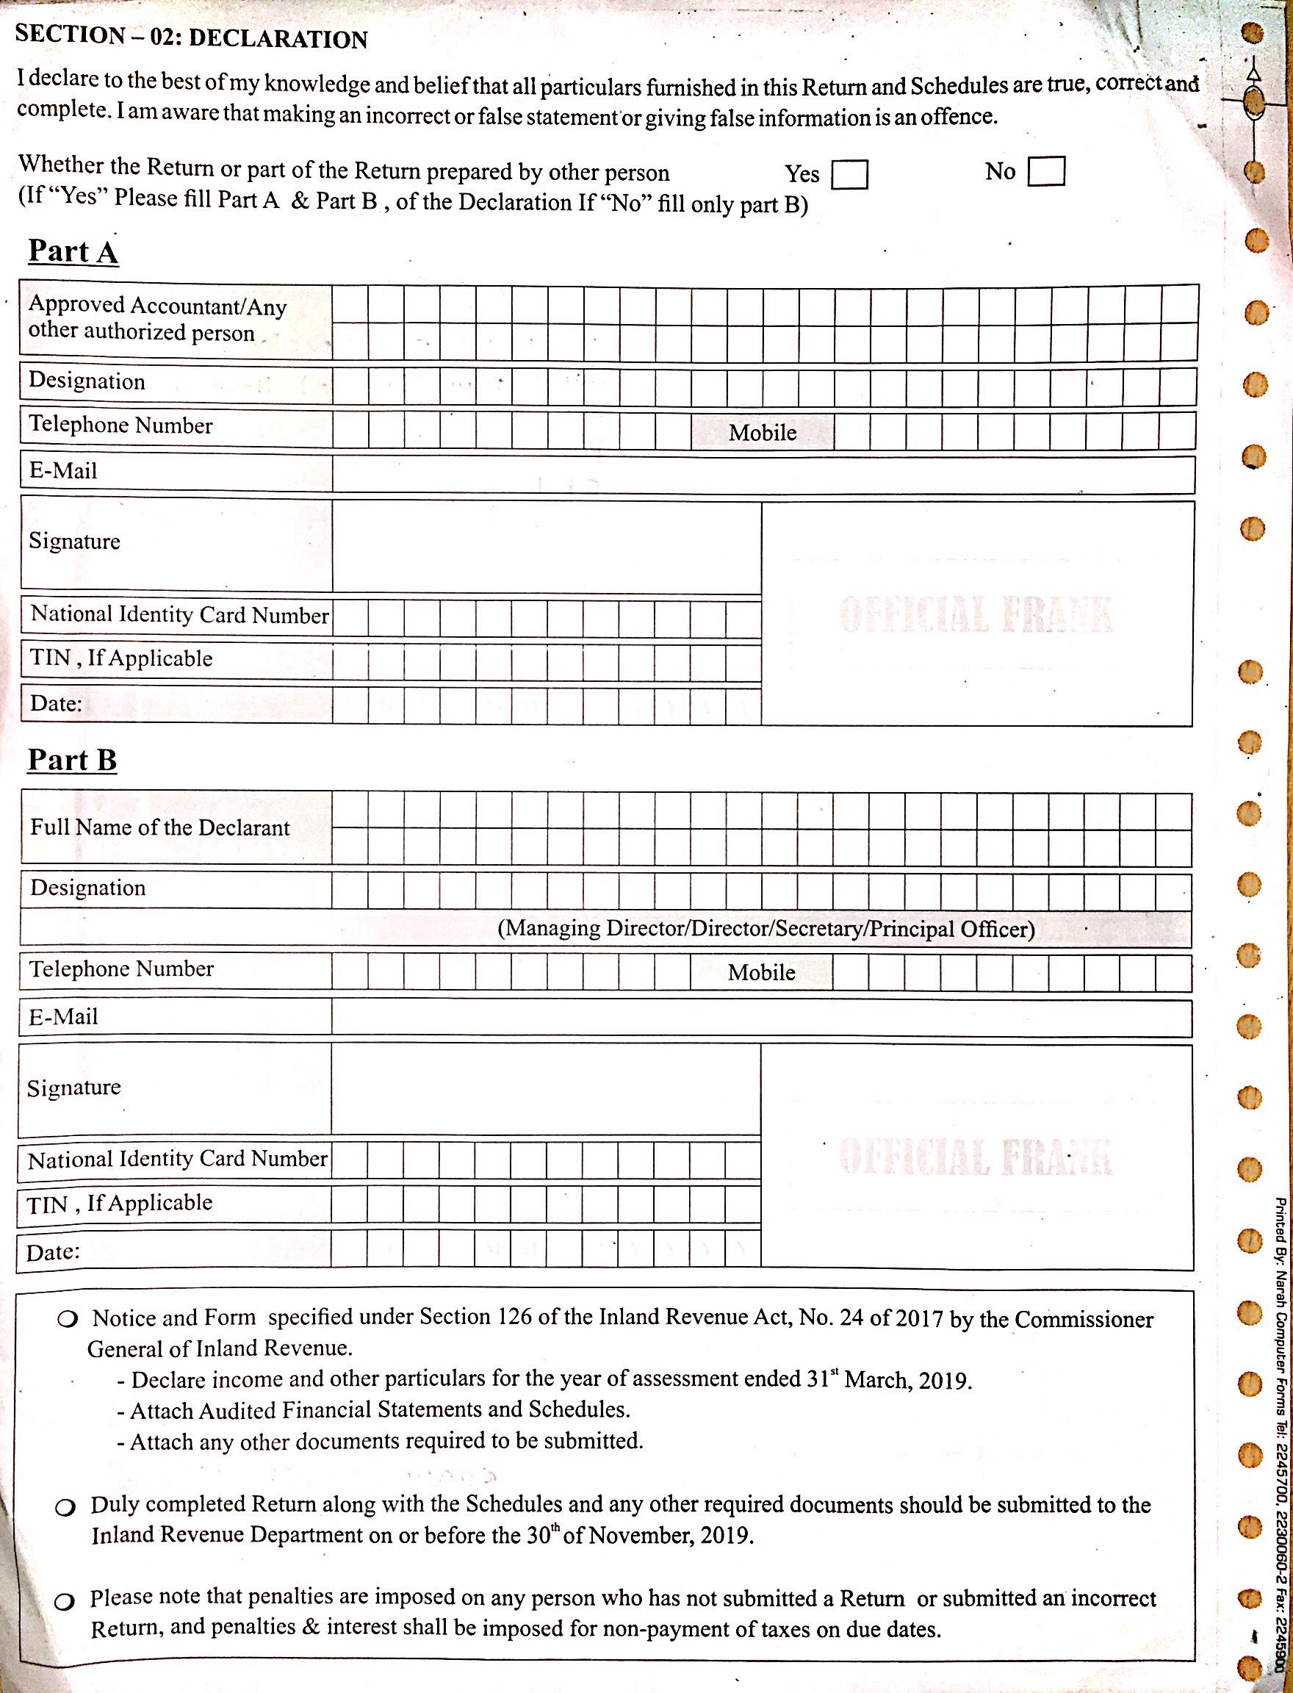
INLAND REVENUE (AMENDMENT) BILL
Annexure 01 – 2018/19
(Sec. 126 Contd…)

Slide 34
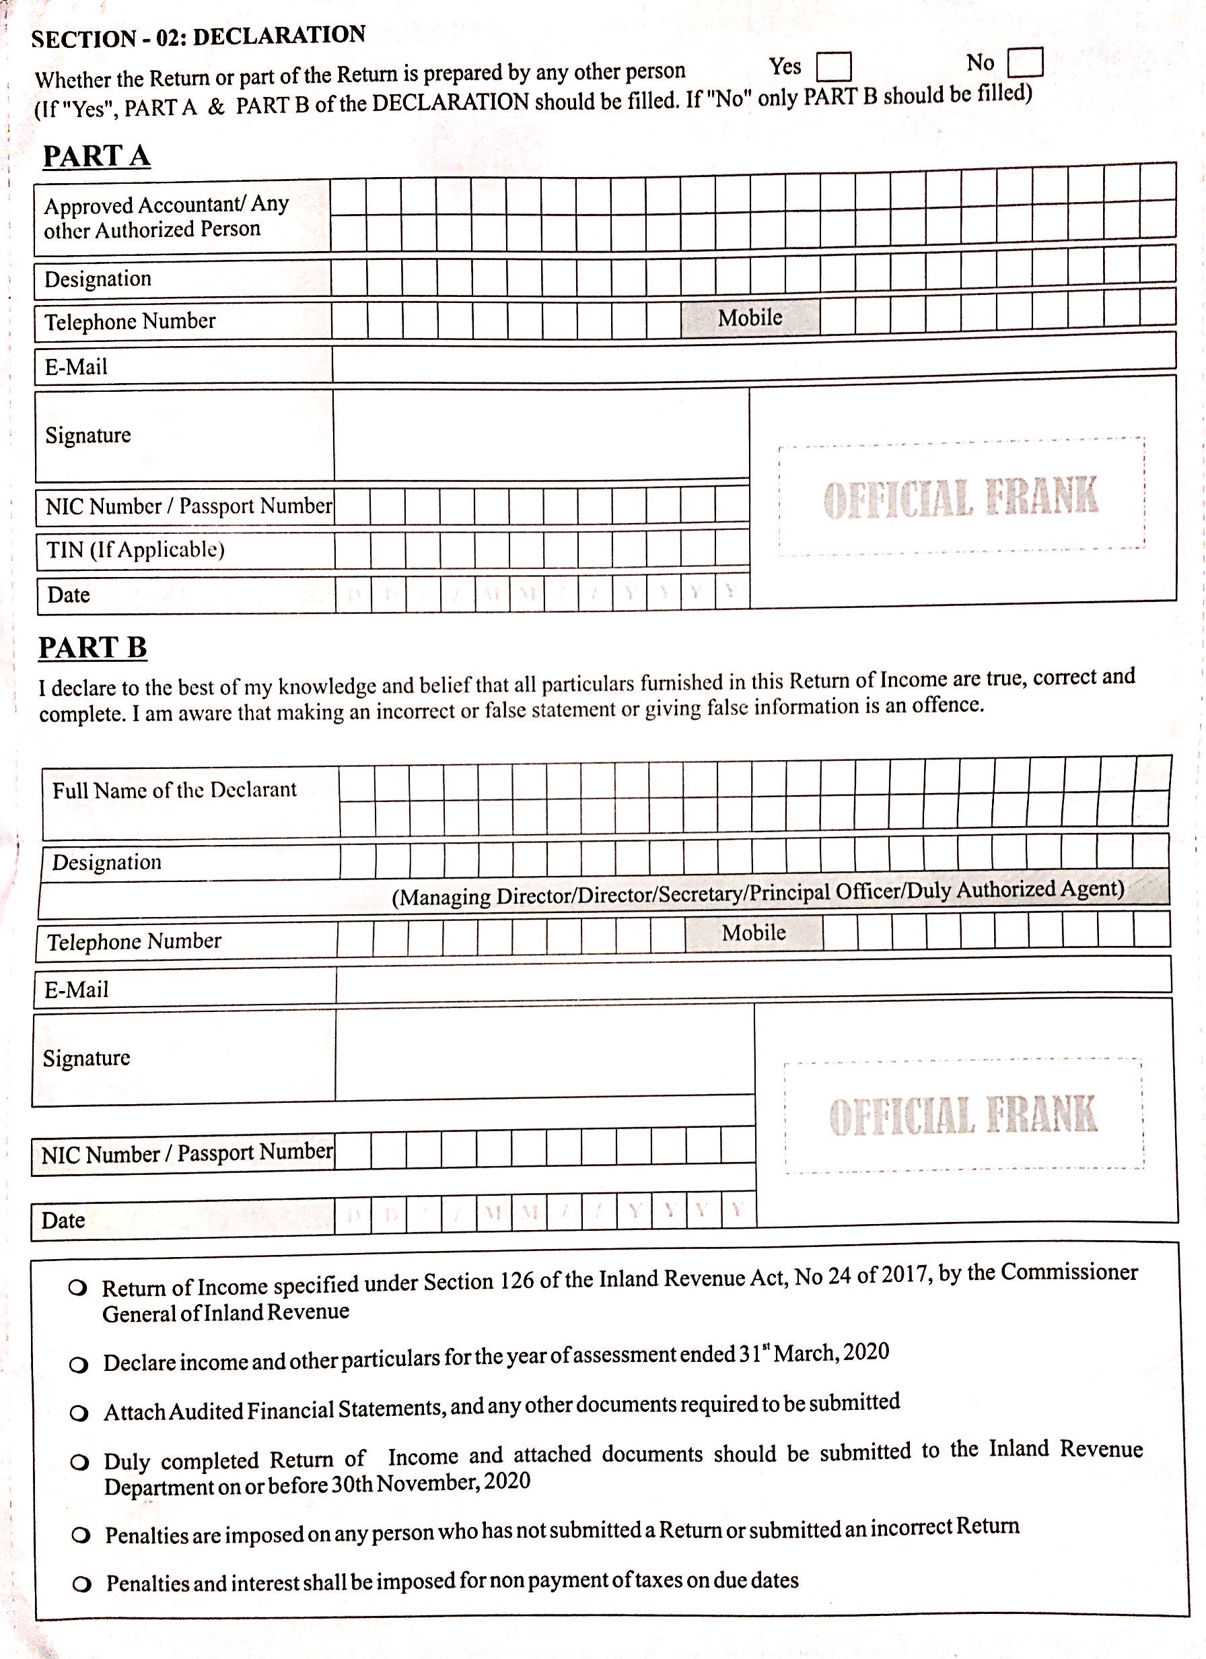
INLAND REVENUE (AMENDMENT) BILL
Annexure 02 – 2019/20
(Sec. 126 Contd…)

Slide 35
INLAND REVENUE (AMENDMENT) BILL 5. Other Changes (Sec. 126 Contd…)
The Bill proposed to amend Act to read as follows;
126(5)Where a return or part of a return was prepared, filled or assisted to prepare or fill for a payment reward by some other person, including by an approved accountant, other than a full-time employee of the taxpayer, that other person shall also sign the return.
• The requirement of taking responsibility on an unknown and unverified information providing by a taxpayer is not fair and not in line with the Constitution of the country. Further, the information provider (i.e. employee) is released.
• Further, the taxpayer is paying fees for advising, computing and/or filling the return with the figures provided by him and not to verify the correctness of the information so provided and hence, if the Government requires the professional to verify the correctness of the information, needs to pay for it to the professional.

Slide 36
INLAND REVENUE (AMENDMENT) BILL 5. Other Changes (Sec. 126 Contd…)
The appellants of the Fundamental Right (F/R) cases filed against the Bill expect amendments to be read as follows;
126(5)Where a return or part of a return was prepared for a payment reward by any other person, including by an approved accountant, such person shall certify separately specifying the extent to which he was involved in the preparation of such return and specify the documents examined by him and the information relied upon by him. Such certification shall be submitted along with the return and the said certification shall be deemed to be part and parcel of the said return.
Accordingly, it is to be certified with specified scope and can produce the certificate on a certifier’s letterhead.

Slide 37
INLAND REVENUE (AMENDMENT) BILL 5. Other Changes (Contd.)
Sec 129 – Return of Information - Amending for broaden the purview of the section.
Sec 139 – Administration Review - Amending for broaden the purview of the section.
Sec 140 – Appeal from Administrative Review - Amending for broaden the purview of the section.
Sec 157 – Interest on Underpayment & Late Payment - Amending for better clarity.
Sec 158 – Interest on Refundable Amounts - Amending to;
• extend the time period for computation of interest. (i.e., “from the date of refund claim filed until the refund is paid”)
• interest nonpayment (graze) period to be increased from 60 days to 6 months.

Slide 38
INLAND REVENUE (AMENDMENT) BILL 5. Other Changes (Contd.) (Sec. 159 & 190)
Sec 159 – Interest Rate - Amending for better clarity.
Sec 190 & 190A –
Impeding Tax Administration – Inserting a new section, (Sec. 190A) to introduce punitive provisions in relation to auditors, tax practitioners, tax advisors or approved accountants –
Sec 190(1) reads as; (The existing law)
A person who willfully impedes or attempts to impede the Department in the administration of this Act shall be guilty of an offence and shall be liable on conviction to a fine not exceeding one million rupees or to imprisonment for a term not exceeding one year or both such fine and imprisonment.

Slide 39
INLAND REVENUE (AMENDMENT) BILL 5. Other Changes (Sec. 190 Contd…)
(2) – For the purposes of this section, a person impedes the administration of this Act if the person—
(a) fails to comply with a lawful request by a tax official to examine documents, records, or data within the control of the person;
(b) fails to comply with a lawful request by a tax official to have the person appear before officials of the Department;
(c) interferes with the lawful right of a tax official to enter into premises;
(d) fails to file a return;
(e) uses a false taxpayer identification number or a taxpayer identification number that does not apply to the person;

Slide 40
INLAND REVENUE (AMENDMENT) BILL 5. Other Changes (Sec. 190 Contd…)
(f) refuses to allow the Commissioner-General or authorized officer to inspect or measure land or refuses to deliver for inspection any map, plan, title deed, instrument of title or other document;
(g) makes a statement to a tax official that is false or misleading in a material particular;
(h) fails to comply with a notice issued under section 170;
(i) fails to maintain required records; or
(j) otherwise impedes the determination, assessment or collection of tax.

Slide 41
INLAND REVENUE (AMENDMENT) BILL 5. Other Changes (Sec. 190A)
Amendment Bill proposed to insert the following new Section 190A;
190A. – Any ¹auditor, ²tax practitioner, ³tax advisor or ⁴approved accountant other than a full-time employee of the taxpayer who-
(a) ¹prepares, ²fills or ³certifies or ⁴assists in preparing, filling or certifying the tax returns, accounts, records, appeals and objections or any other document or information to furnish to the Commissioner-General; and
(b) ¹intentionally disregards or fails to take reasonable care in discharging the professional duty, or ²fraudulently prepares and certifies such document or information or ³deliberately misinterprets any provision of this Act or any other Act administered by the Commissioner-General, or any regulation, rule or order made thereunder,
commits an offence under this Act, and on conviction after summary trial before a Magistrate, be liable to ¹a fine not exceeding one million rupees or to ²imprisonment of either description for a term not exceeding six months or for a ³prohibition order preventing him from practicing in such capacity.”

Slide 42
INLAND REVENUE (AMENDMENT) BILL 5. Other Changes (Sec. 190A Contd…)
Related Issues with this proposed amendment; (These issues are covered with the F/R Cases filed with S/Court where the determination is issued on 07.04.2021– See slide No. 45)
(i) Is the loading of such responsibilities to an auditor, tax practitioner, tax advisor or approved accountant fair, and correct?
(ii) Can it be done under the Constitution of the country?
(iii) Who is a tax practitioner and/or a tax advisor? (not defined)
(iv) Who is paying to these listed persons?
(v) To whom they should provide services?
(vi) Is the Government ready to pay for the additional services (verification) expecting from these persons by this amendment?

Slide 43
INLAND REVENUE (AMENDMENT) BILL 5. Other Changes (Sec. 190A Contd…)
(vii) Can any of these listed persons take the responsibility of the information not verified by themselves?
(viii) Which law requires him to verify those information?
(ix) If so, why the law expects a thing which cannot be done obviously?
(x) Is the section 190A drafted properly & legally to cover the expected goals?
(xi) Isn’t it create a tax fear which will adversely affect to the application of the tax Law?
(xii) Does it want to create a fear among the professionals not to provide services in relation to appealing & objections?

Slide 44
INLAND REVENUE (AMENDMENT) BILL 5. Other Changes (Sec. 190A Contd…)
(xiii) By using the words intentionally, fraudulently, deliberately misinterprets, is there any assurance that some tax officials may not misuse those?
(xiv) If misused, isn’t it result the wasting of the taxpayers’ money & productive time in challenging with the courts?
(xv) How come any other Act covers with it & if it is possible, is it fair?
(xvi) Who has granted the practicing license & who could restrict it?
(xvii) With the above restrictions what the use of having professional bodies?

Slide 45
INLAND REVENUE (AMENDMENT) BILL 5. Other Changes (Sec. 190A Contd…)
The appellants of the F/R cases filed against the Bill expect the amendment to be read as follows;
190A. – Any person who fraudulently;
(a) ¹prepares, any documents or information,
or
(b) ²certifies a document
to be furnished to the Commissioner-General, commits an offence under this Act, and on conviction after summary trial before a Magistrate, be liable to ¹a fine not exceeding one million rupees or to ²imprisonment of either description for a term not exceeding six months.

Slide 46
INLAND REVENUE (AMENDMENT) BILL 5. Other Changes (Contd.)
Sec 195 – Interpretations – Some new interpretations are included;
Agricultural Business (w.e.f. 01.04.2019)
“agricultural business” means the business of ¹agro farming or ²agro processing, but excludes farming of, or processing of liquor or tobacco produces or products,”
Agro Farming (w.e.f. 01.04.2019)
¹“agro farming” means
(a) the tillage of the soil and cultivation of land with plants of any description, cultivation in green house, bee-keeping, rearing of fish, shrimp farming or animal husbandry, poultry farms, hatchery, veterinary or artificial insemination services;
The above part (a) is specific & clear.

Slide 47
INLAND REVENUE (AMENDMENT) BILL 5. Other Changes (Contd.)
(b) the cleaning, sizing, sorting, grading, cutting or chilling of any produce produced out of any activity referred to in paragraph (a) by any person who is engaged in any such activity, in preparation of such produce for the market but excludes the agro or food processing;
The term “Food Processing” is not interpreted?
By trying to made some liable at 14% certain obvious & mandertory primary activities are missing in the above resulting some types of cultivations (farming)/ might be badly affected?
Agro Processing (w.e.f. 01.04.2019)
²“agro processing” means the processing of any locally produced agricultural, fishing, or animal product and includes an undertaking for the dehydrating, milling, packaging, canning for the purpose of changing the form, contour or physical appearance of such product in preparation for the market but excludes an undertaking of deep-sea fishing or manufacturing;”

Slide 48
INLAND REVENUE (AMENDMENT) BILL 5. Other Changes (Contd.)
Manufacture
“manufacture” means a change in a non-living physical object, article or thing-
resulting in transformation of such object, article or thing into a new and distinct object, article or thing having a different name, character or use; or
bringing into existence of a new and distinct object, article or thing with a different chemical composition or integral structure;”;
Sri Lankan Permanent Establishment
“Sri Lankan permanent establishment” means any business connection or fixed place of business through which the business of the enterprise is wholly or partly carried out, irrespective of the number of days of such business being carried out in Sri Lanka;”

Slide 49
INLAND REVENUE (AMENDMENT) BILL 5. Other Changes (Contd.)
Tertiary and Vocational Education Commission
“Tertiary and Vocational Education Commission” means the Tertiary and Vocational Education Commission established under the Tertiary and Vocational Education Act, No. 20 of 1990;”.
Sec 201 – Temporary Concessions - Sixth schedule validity period extended from 5 years to 7 years.
Sec 203 – Transitional Provisions – Sub paragraph (5) amends.
Schedules to the Act – All six schedules are also amending.

Slide 50
FOR FURTHER CLARIFICATIONS PLEASE COMMUNICATE WITH US ………
ATHULA RANAWEERA (BSc., FCA, FCMA, FMAAT) Managing Partner: Ranaweera Associates (Chartered Accountants)
Managing Director - Assent Advisory Partners (Pvt) Ltd.
Assent Secretarial Consultants (Pvt) Ltd.
+94 777 305 123,
athula@ranaweeraasso.lk athula@assentadvisory.lk

